Slide 1
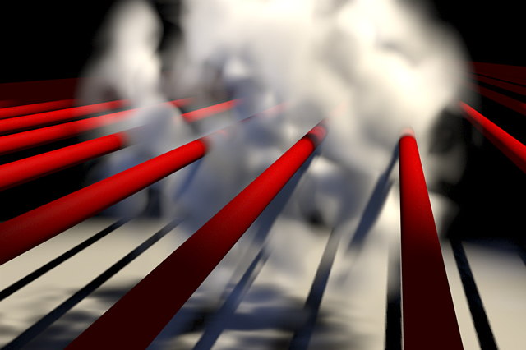
Shadow Mapping
TYSON BIZZIGOTTI

Slide 2
Shadow Mapping Intro
Introduced in 1978 and is now widely used in real time graphics.
Adds a level of realism to a scene with a two pass algorithm.
First pass renders a scene from the light’s point of view storing the depth of each pixel into an image.
Second pass renders a scene from the eye’s point of view including shadow determination for each pixel.
If the depth of a pixel is greater than the stored depth it is in the shadow, otherwise it is visible.
Introduces aliasing, or the effect of ‘different continuous signals to become indistinguishable when sampled’.
There are multiple types of maps that deal with the issue of aliasing, quality, and render speed.
Perspective, adaptive, deep, trapezoidal, and variance opacity.

Slide 3
Why Multiple Mappings?
Standard algorithm has several flaws.
Resolution problem.
As light moves further away from eye/viewpoint aliases are produced from low resolution maps.
Polygon offset problem.
Surface distortion effects caused by inaccurate depth buffer values.
Continuity Problem
Significant change in shadow map quality from one frame to another. Results In shadow flickering.

Slide 4
Perspective Shadow Map
Generated after perspective transformation in normalized coordinate space.
Generating after perspective transformation aids in the reduction of aliasing (distortion).
Low overhead since generated after perspective transformation.
May be used to replace standard shadow maps for hardware accelerated rendering.

Slide 5
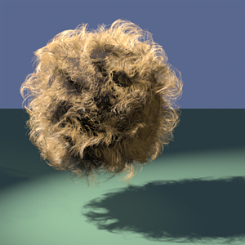


Deep Shadow Map
Useful for smoke, hair, fur, etc. (fine partial transparent systems).
Requires less memory than a standard shadow map (pre-filtered).
Stores a ‘visibility function’ for each pixel in an array.
The function value is the fraction of the light’s power that penetrates to a given depth.

Slide 6
Adaptive Shadow Map
Stores the light source view as a hierarchical grid structure rather than a flat structure.
The adaptive shadow map creates high resolution maps as needed (generally the shadow boundaries).
Done when the pixels are transferred from the eye view to the light view.
Stated that adaptive shadow maps yield improved quality while maintaining speed.

Slide 7
Variance Shadow Map
Stores depth and depth squared (first and second moments).
Utilizes moments to approximate the distribution that is more distant than the surface being shaded.
Allows shadow maps to be pre-filtered (anti-aliased).
To further reduce aliasing, the variance shadow map may be blurred.
May be implemented on current graphics hardware.

Slide 8
Trapezoidal Shadow Map
Based on standard shadow map algorithm.
Basic technique is to use a trapezoid to approximate the eye’s frustum and warp that onto a shadow map.
Step 1 Transform the eye's frustum into postperspective space L of the light to obtain E.
Step 2 Compute center line l, which passes through the near and far plane centers of E.
Step 3 Calculate the 2D convex hull of E (with at most six vertices on its boundary).
Step 4 Calculate the top line l(t) that is orthogonal to l and touches the boundary of the convex hull of E. l(t) intersects l at a point closer to the center of the near plane than that of the far plane of E.
Step 5 Calculate the base line lb which is parallel to (and different from) the top line l(t) (i.e., orthogonal to l too) and touches the boundary of the convex hull of E.
http://www.comp.nus.edu.sg/~tants/tsm/video_640x480_low.mp4

Slide 9
Opacity Shadow Map
Heavy use of graphics hardware.
Operate on primitives such as points, lines, and polygons.
Created perpendicular to the light’s direction and rendered to the alpha buffer.
Alpha values store relative opacity of the pixel at each location.
Linear interpolations of adjacent opacity values are used to calculate shadowed shading.
Useful for discontinuous volumes (not solid) such as hair, fur, smoke, particles, etc.

Slide 10
Conclusion
Shadows will always play an important role in 3D video games.
There are various techniques used to generate shadows.
Two main issues are quality and processing speed.
Shadow maps provide improved quality over older techniques.
Shadow maps function with primitives and complicated scenes.
Hardware supported. (NVIDIA)

Slide 11
Sources
Shadow Mapping, Wikipedia - http://en.wikipedia.org/wiki/Shadow_mapping
Cass Everitt, Ashu Rege, Cem Cebenoyan. Hardware Shadow Mapping. http://developer.nvidia.com/attach/8456.
Mark J. Kilgard. Shadow Mapping with Today’s OpenGL Hardware. CEDEC 2001. http://developer.nvidia.com/attach/6769.
Michael Wimmer, Daniel Scherzer and Werner Purgathofer. Light Space Perspective Shadow Maps. Vienna University of Technology, Austria. 2004. http://www.eg.org/EG/DL/WS/EGWR/EGSR04/143-151.pdf.abstract.pdf.
Tom Lokovic, Eric Veach. Deep Shadow Maps. Pixar Animation Studios. http://graphics.pixar.com/DeepShadows/paper.pdf.
Randima Fernando, Sebastian Fernandez, Kavita Bala, Donald P. Greenberg. Adaptive Shadow Maps. Program of Computer Graphics Cornell University. 2001. http://www.graphics.cornell.edu/pubs/2001/FFBG01.pdf.
Andrew Lauritzen. Variance Shadow Maps. nVIDIA. 2006. http://download.nvidia.com/developer/presentations/2006/gdc/2006-GDC-Variance-Shadow-Maps.ppt.
Tobias Martin, Tiow-Seng Tan. Anti-aliasing and Continuity with Trapezoidal Shadow Maps. School of Computing, National University of Singapore. 2004. http://www.comp.nus.edu.sg/~tants/tsm.html.
Cem Yuksel, John Keyser. Deep Opacity Maps. Department of Computer Science, Texas A&M University. 2007. http://www.cs.tamu.edu/academics/tr/tamu-cs-tr-2007-6-1.

